Slide 1
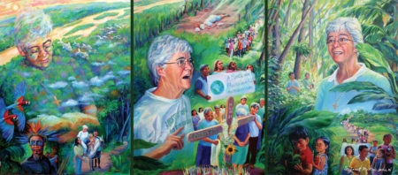

Slide 2
We ask that our hearts be open to the voice of God in our midst.

Slide 3
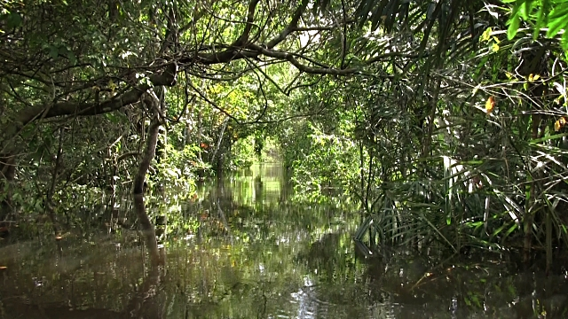

Slide 4
We open our hearts to do your will, Lord.

Slide 5
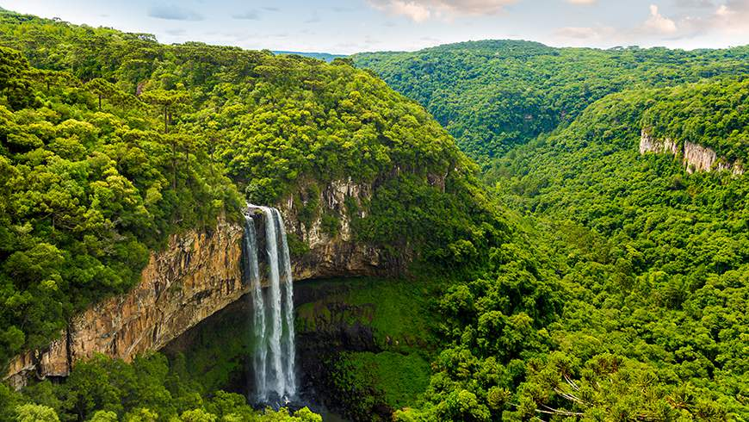

Slide 6
We open our hearts to do your will, Lord.

Slide 7
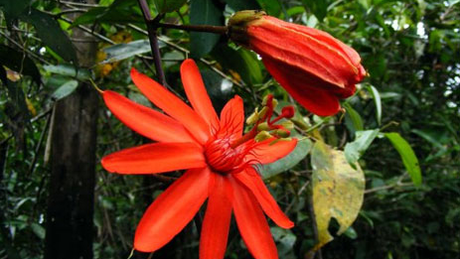

Slide 8
We open our hearts to do your will, Lord.

Slide 9
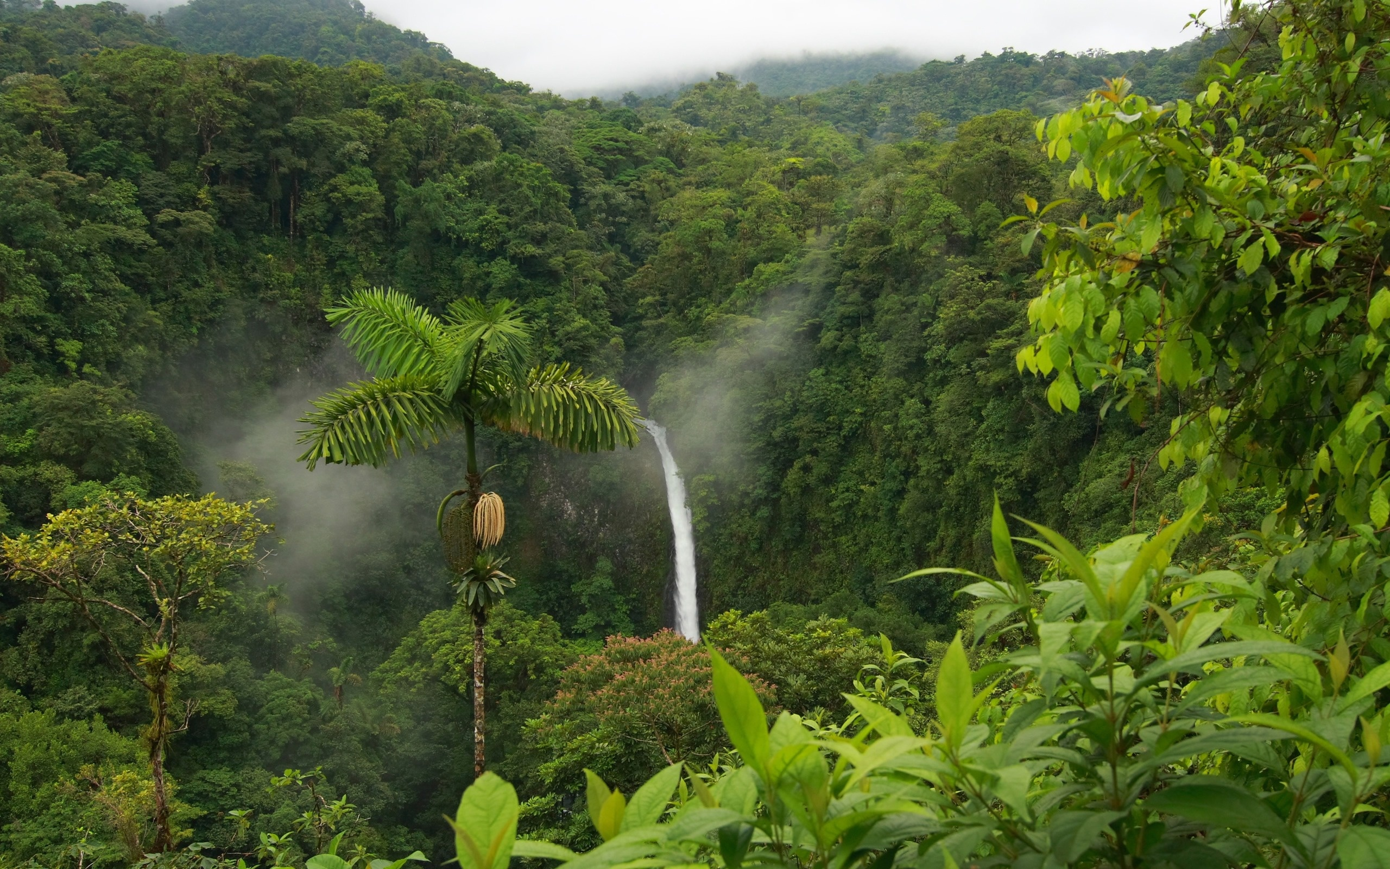

Slide 10
We open our hearts to do your will, Lord.

Slide 11
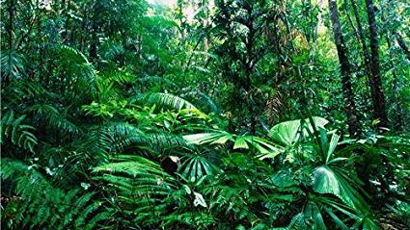

Slide 12
We open our hearts to do your will, Lord.

Slide 13
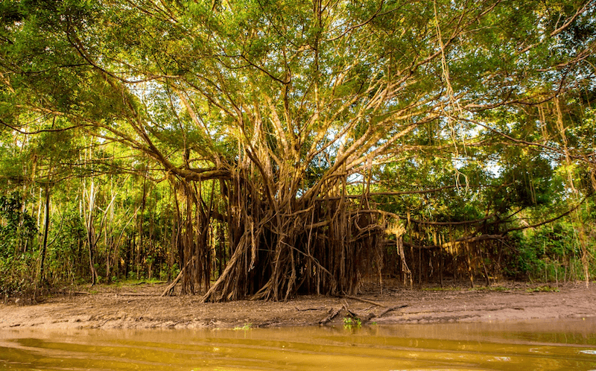

Slide 14
We open our hearts to do your will, Lord.

Slide 15
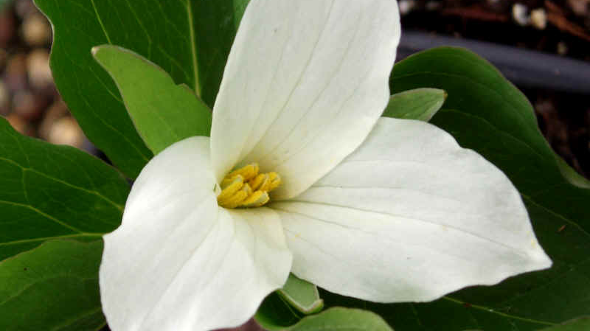

Slide 16
We open our hearts to do your will, Lord.

Slide 17
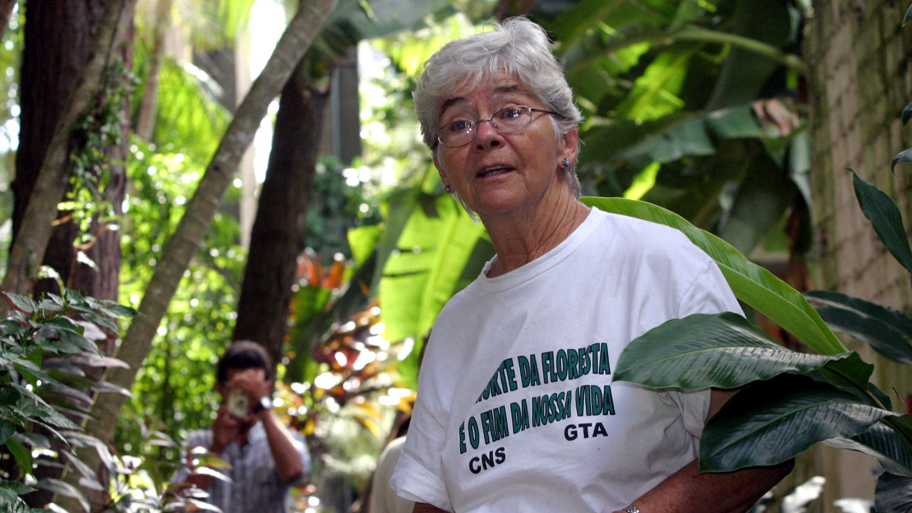

Slide 18
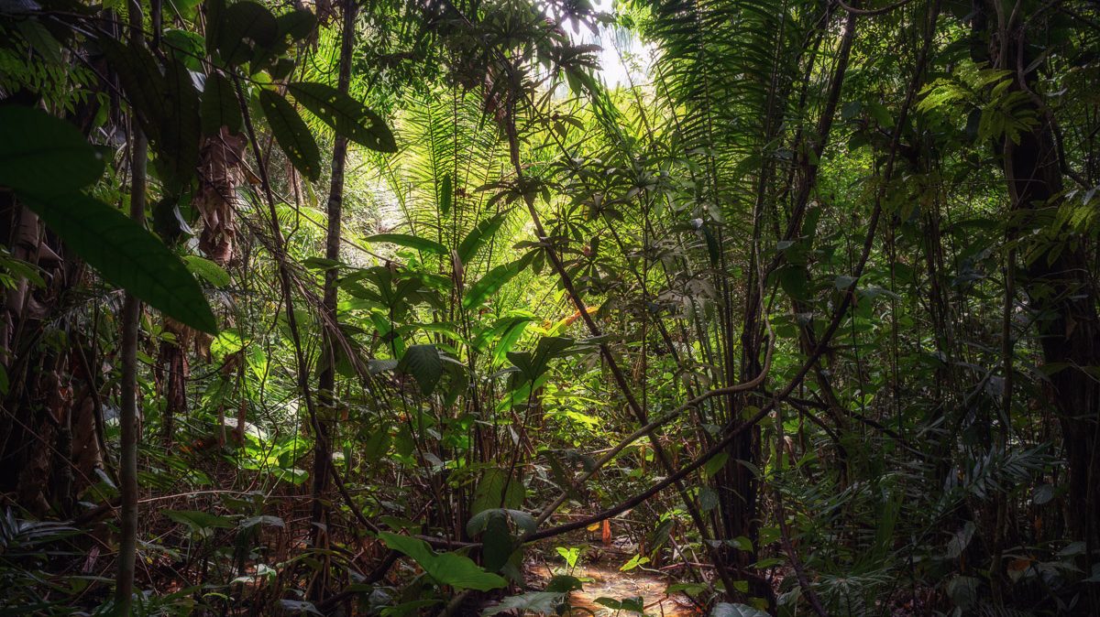

Slide 19
We open our hearts to do your will, Lord.

Slide 20
A: We believe that where people are gathered together in love, God is present and good things happen and life is full.

Slide 21
B: We believe that we are immersed in mystery; that our lives are more than they seem; that we belong to each other and to a universe of great creative energies whose source and destiny is God.

Slide 22
A: We believe that God is after us; that God is calling to us from the depths of human life. We believe that God risked all and shared our life in Jesus. In and with Jesus we believe that each of us is situated in the love of God. And the pattern of our life will be the pattern of Jesus through death and resurrection.

Slide 23
B: We believe that the Spirit of Peace is present with us when we gather to celebrate our common existence, the resurrection of Jesus, and the fidelity of God. And most deeply we believe that in our struggle to love, we incarnate God in the world.

Slide 24
ALL: And so, aware of mystery and wonder, caught up in friendship and laughter, we stand speechless before the joy in our hearts and we celebrate the sacredness of all life. Amen.

